Slide 1

GARBAGE CLASSIFICATION
Using CNN
with
Team: Lasya, Tejaswi, Vaibhavi

Slide 2

The world produces more than 3.5 million tons of garbage a day — and that figure is growing.
Source: https://www.washingtonpost.com/graphics/2017/world/global-waste/?noredirect=on&utm_term=.a4f6ea894de5

Slide 3
TRASH BY THE NUMBERS
4.4 pounds: The amount of trash generated daily, on average, by every American. Packed in cubed feet it would be the height of the Leaning Tower of Pisa.
254 million tons: The amount of trash that is generated in US in a year.
300: Laps around the equator that could be made in paper and plastic cups, forks, and spoons disposed of annually.
12 feet: The height of a wall from Los Angeles to New York City that could be made from tossed office paper every year.
Source: https://www.treehugger.com/environmental-policy/trash-numbers-startling-statistics-about-americans-and-their-garbage.html

Slide 4
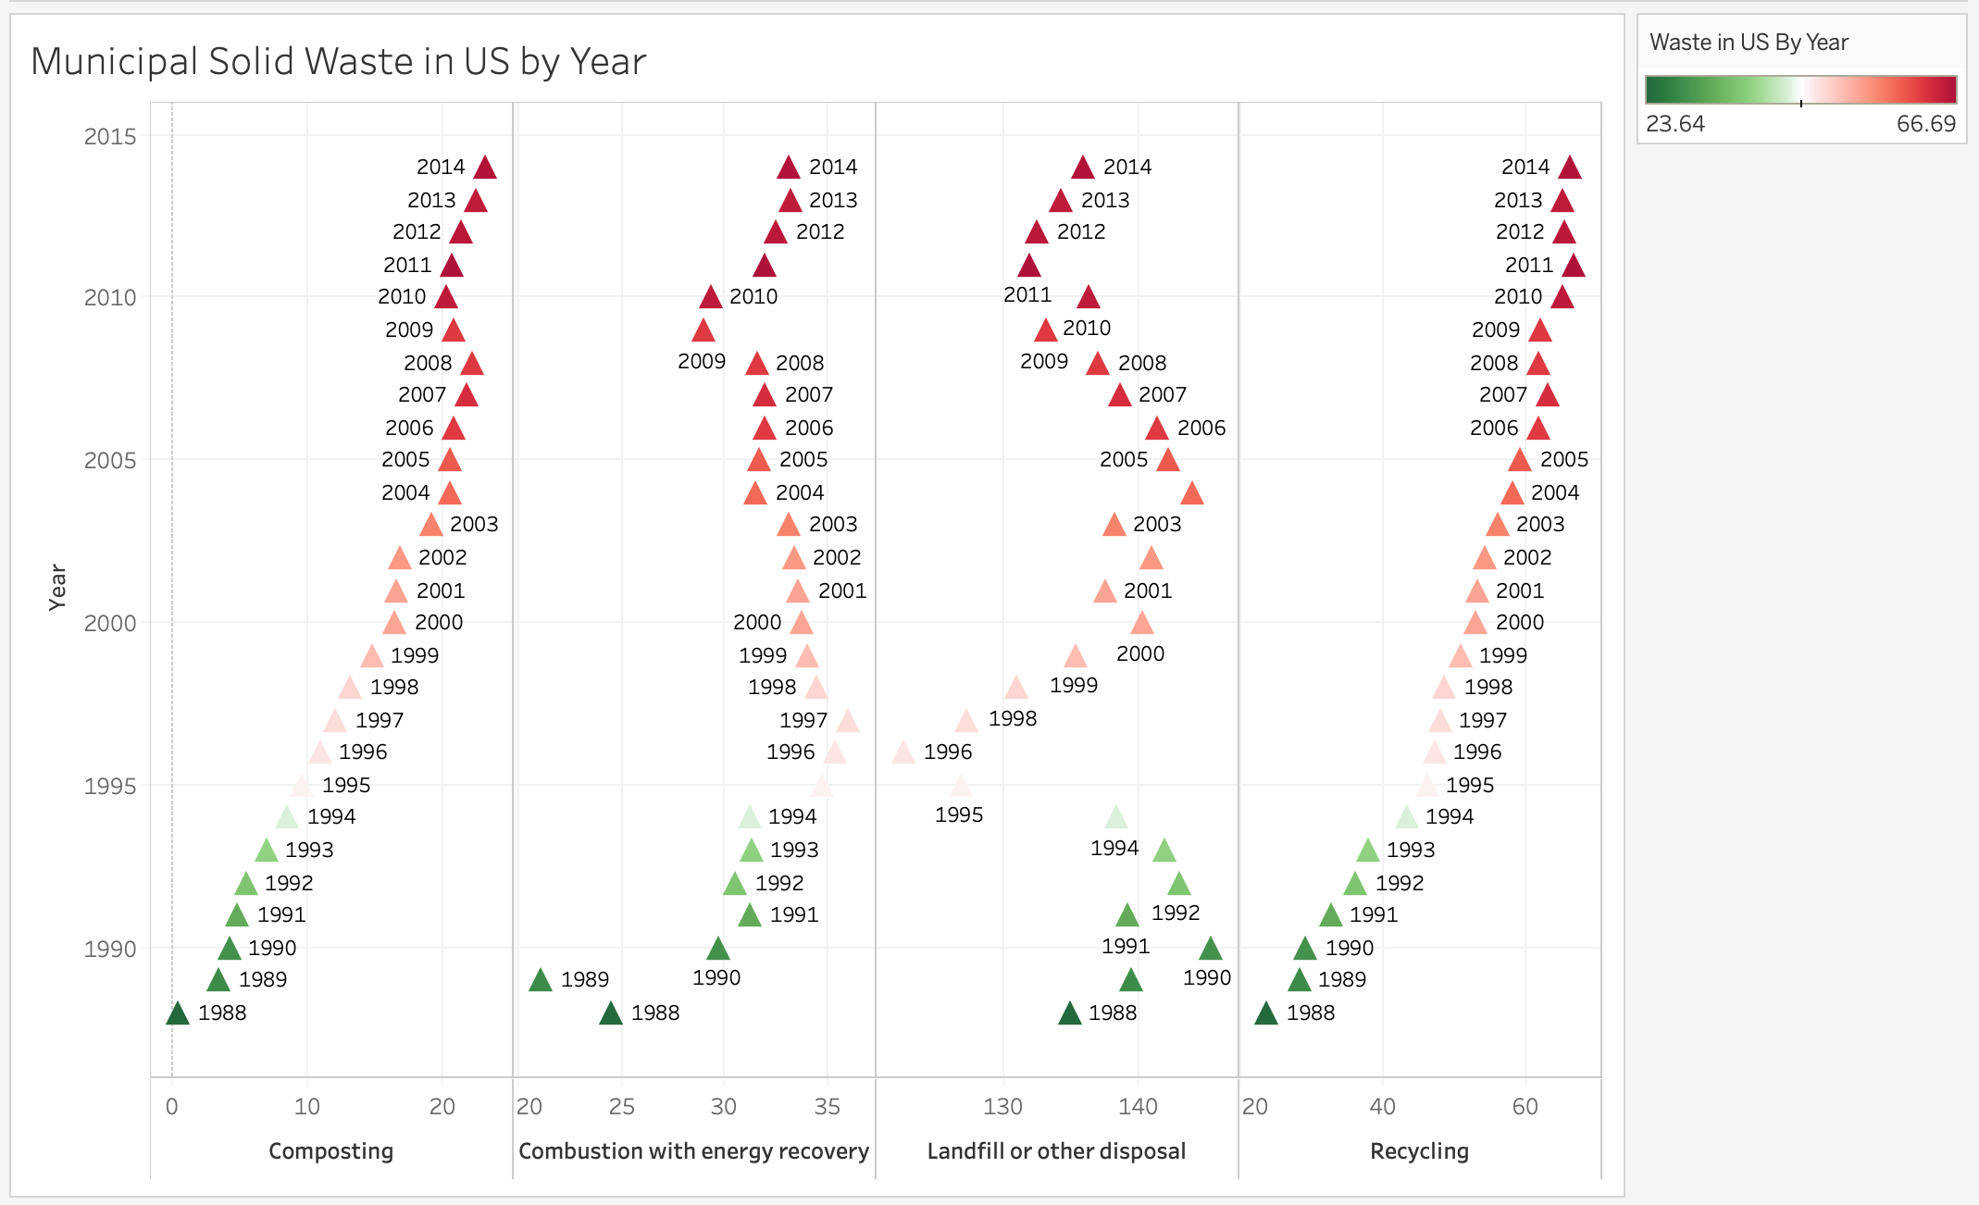
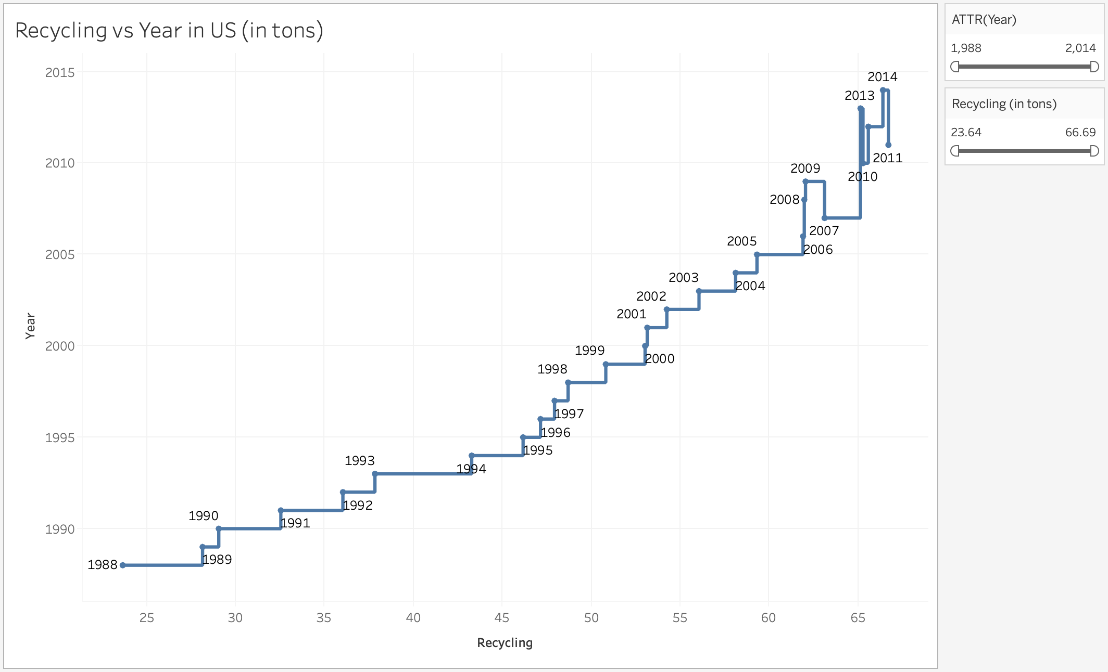
GROWING AMOUNT
OF WASTE IN US
PER YEAR

Slide 5
But the REAL problem is not the ‘amount’ of trash.
IT IS THE IGNORANCE OF WHAT IS RECYCLABLE AND WHAT IS NOT.

Slide 6
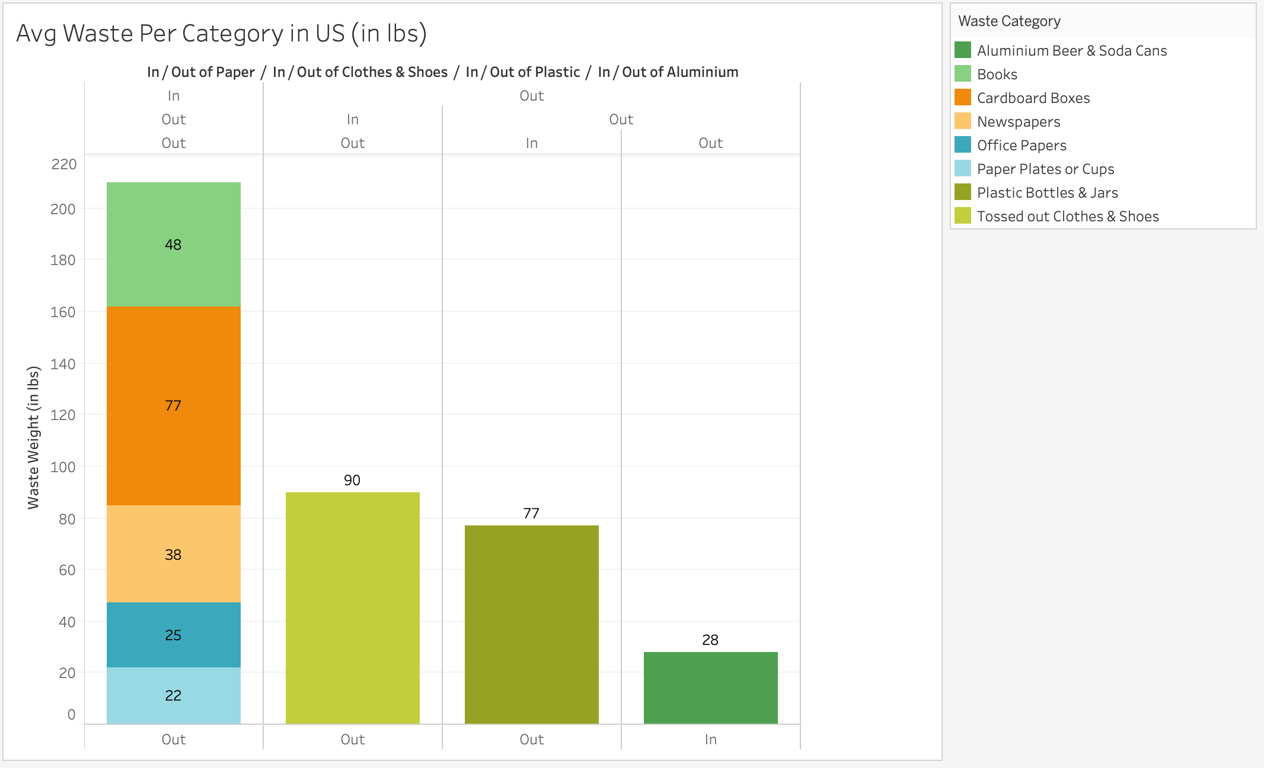
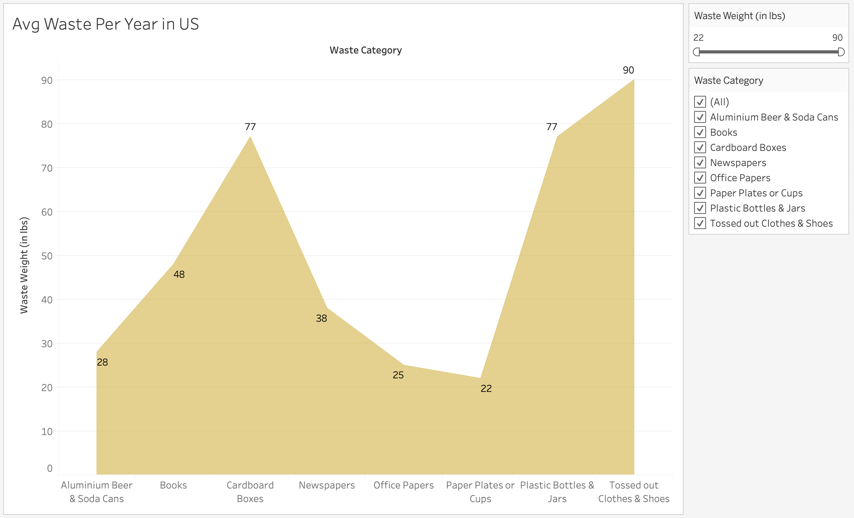
AVERAGE WASTE IN US
PER CATEGORY

Slide 7
The EPA estimates that 75% of the American waste stream is recyclable, but we only recycle about 30% of it.
Source: Environmental Protection Agency
https://www.epa.gov/

Slide 8
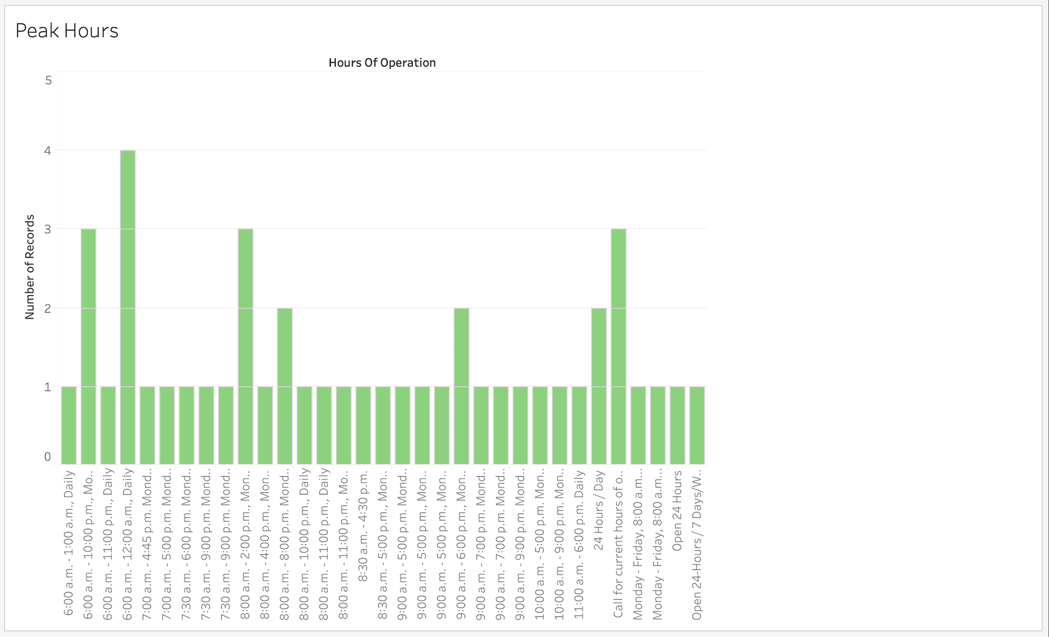
INCONVENIENT
HOURS OF
WASTE RECOVERY?

Slide 9
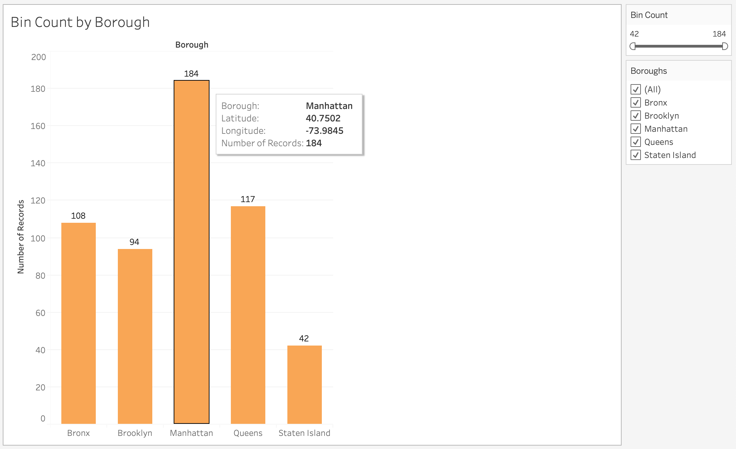
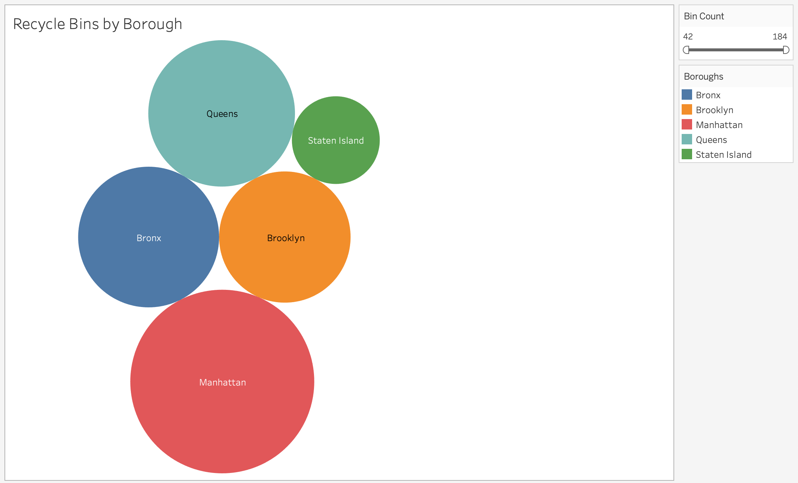
INSUFFICIENT RECYCLE
BINS BY BOROUGH?

Slide 10
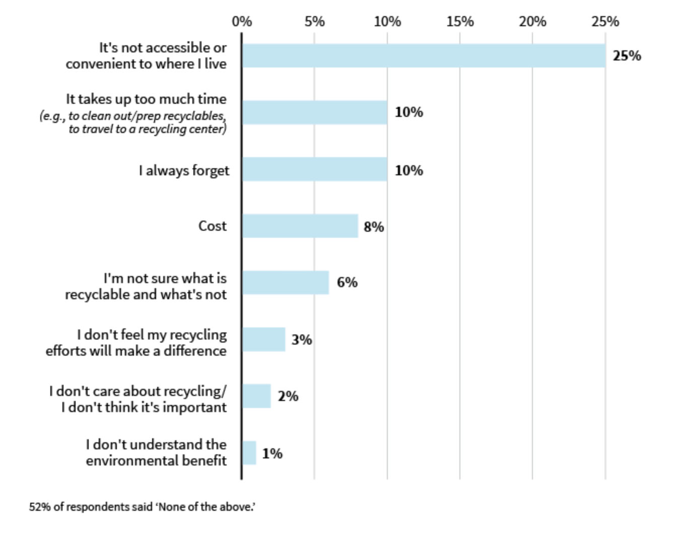
THE PSYCHOLOGY BEHIND NOT RECYCLING
Source: https://www.huffpost.com/entry/psychology-of-why-people-dont-recycle_n_57697a7be4b087b70be605b3

Slide 11
The Inspiration Behind This Project…
Our TEST & TRAIN MODEL that aims at showing how to CLASSIFY TRASH.

Slide 12
Test. Train. Validate.

Slide 13
HOW IT WORKS
Nearly 500 unique images of trash per category
Model tested, trained and validated to classify category:
['paper’, 'metal', 'cardboard', 'trash’, 'glass', 'plastic']

Slide 14
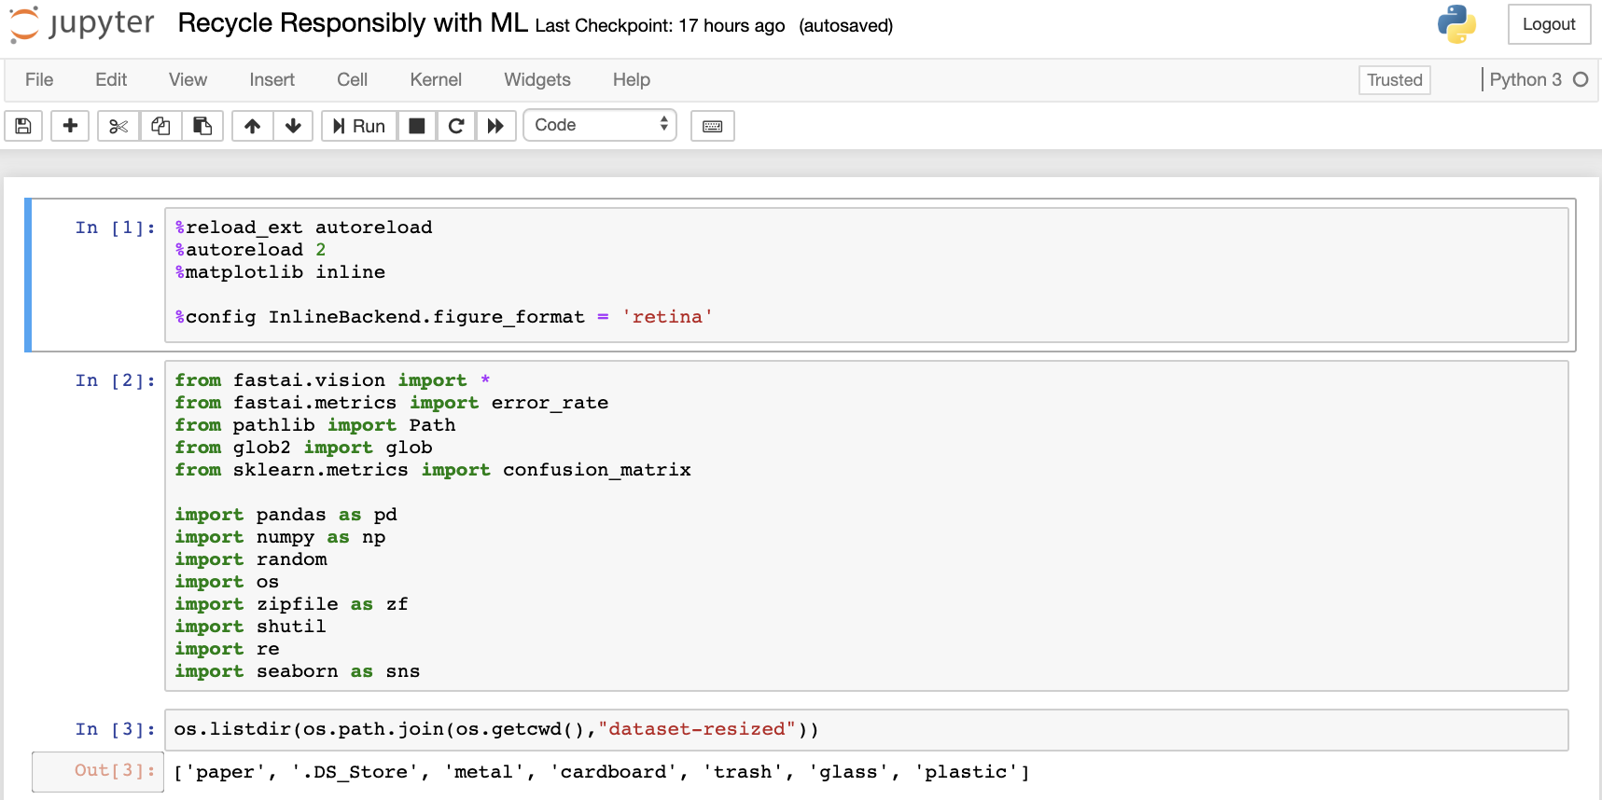
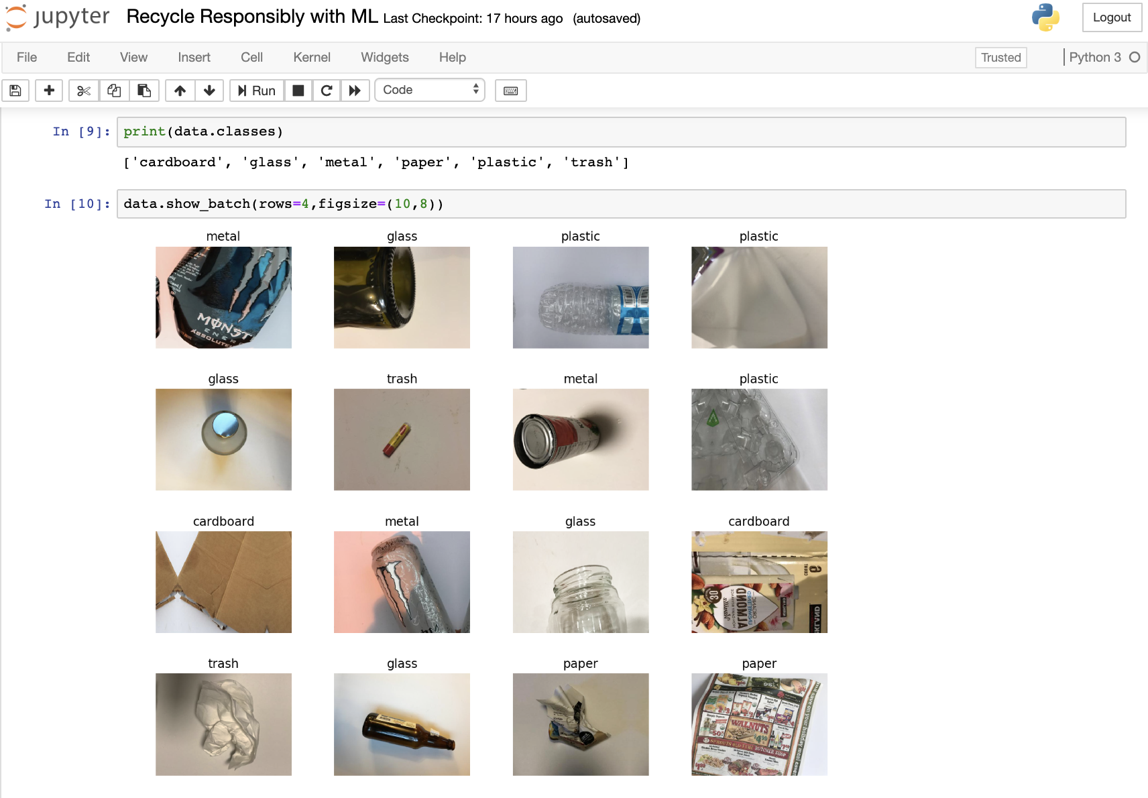

Slide 15
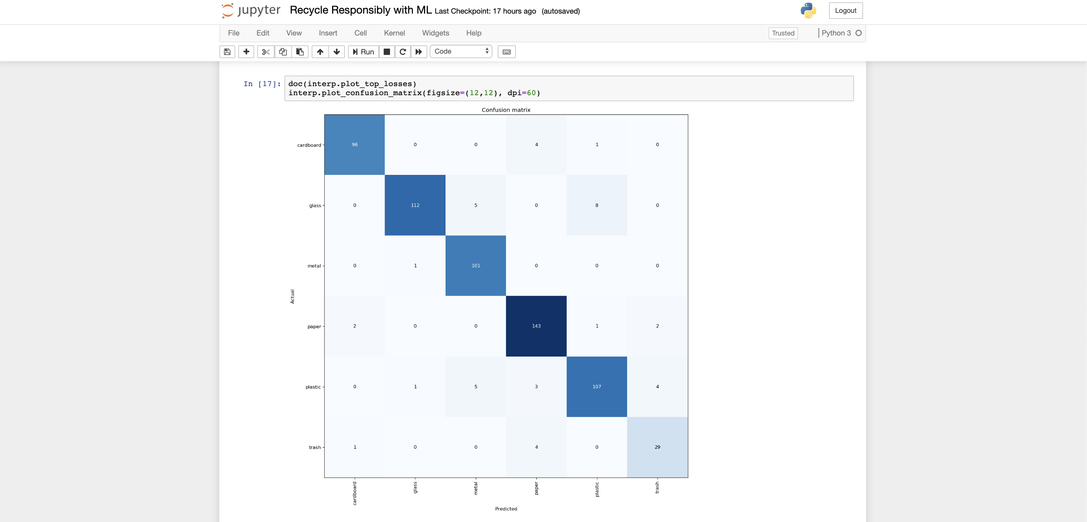
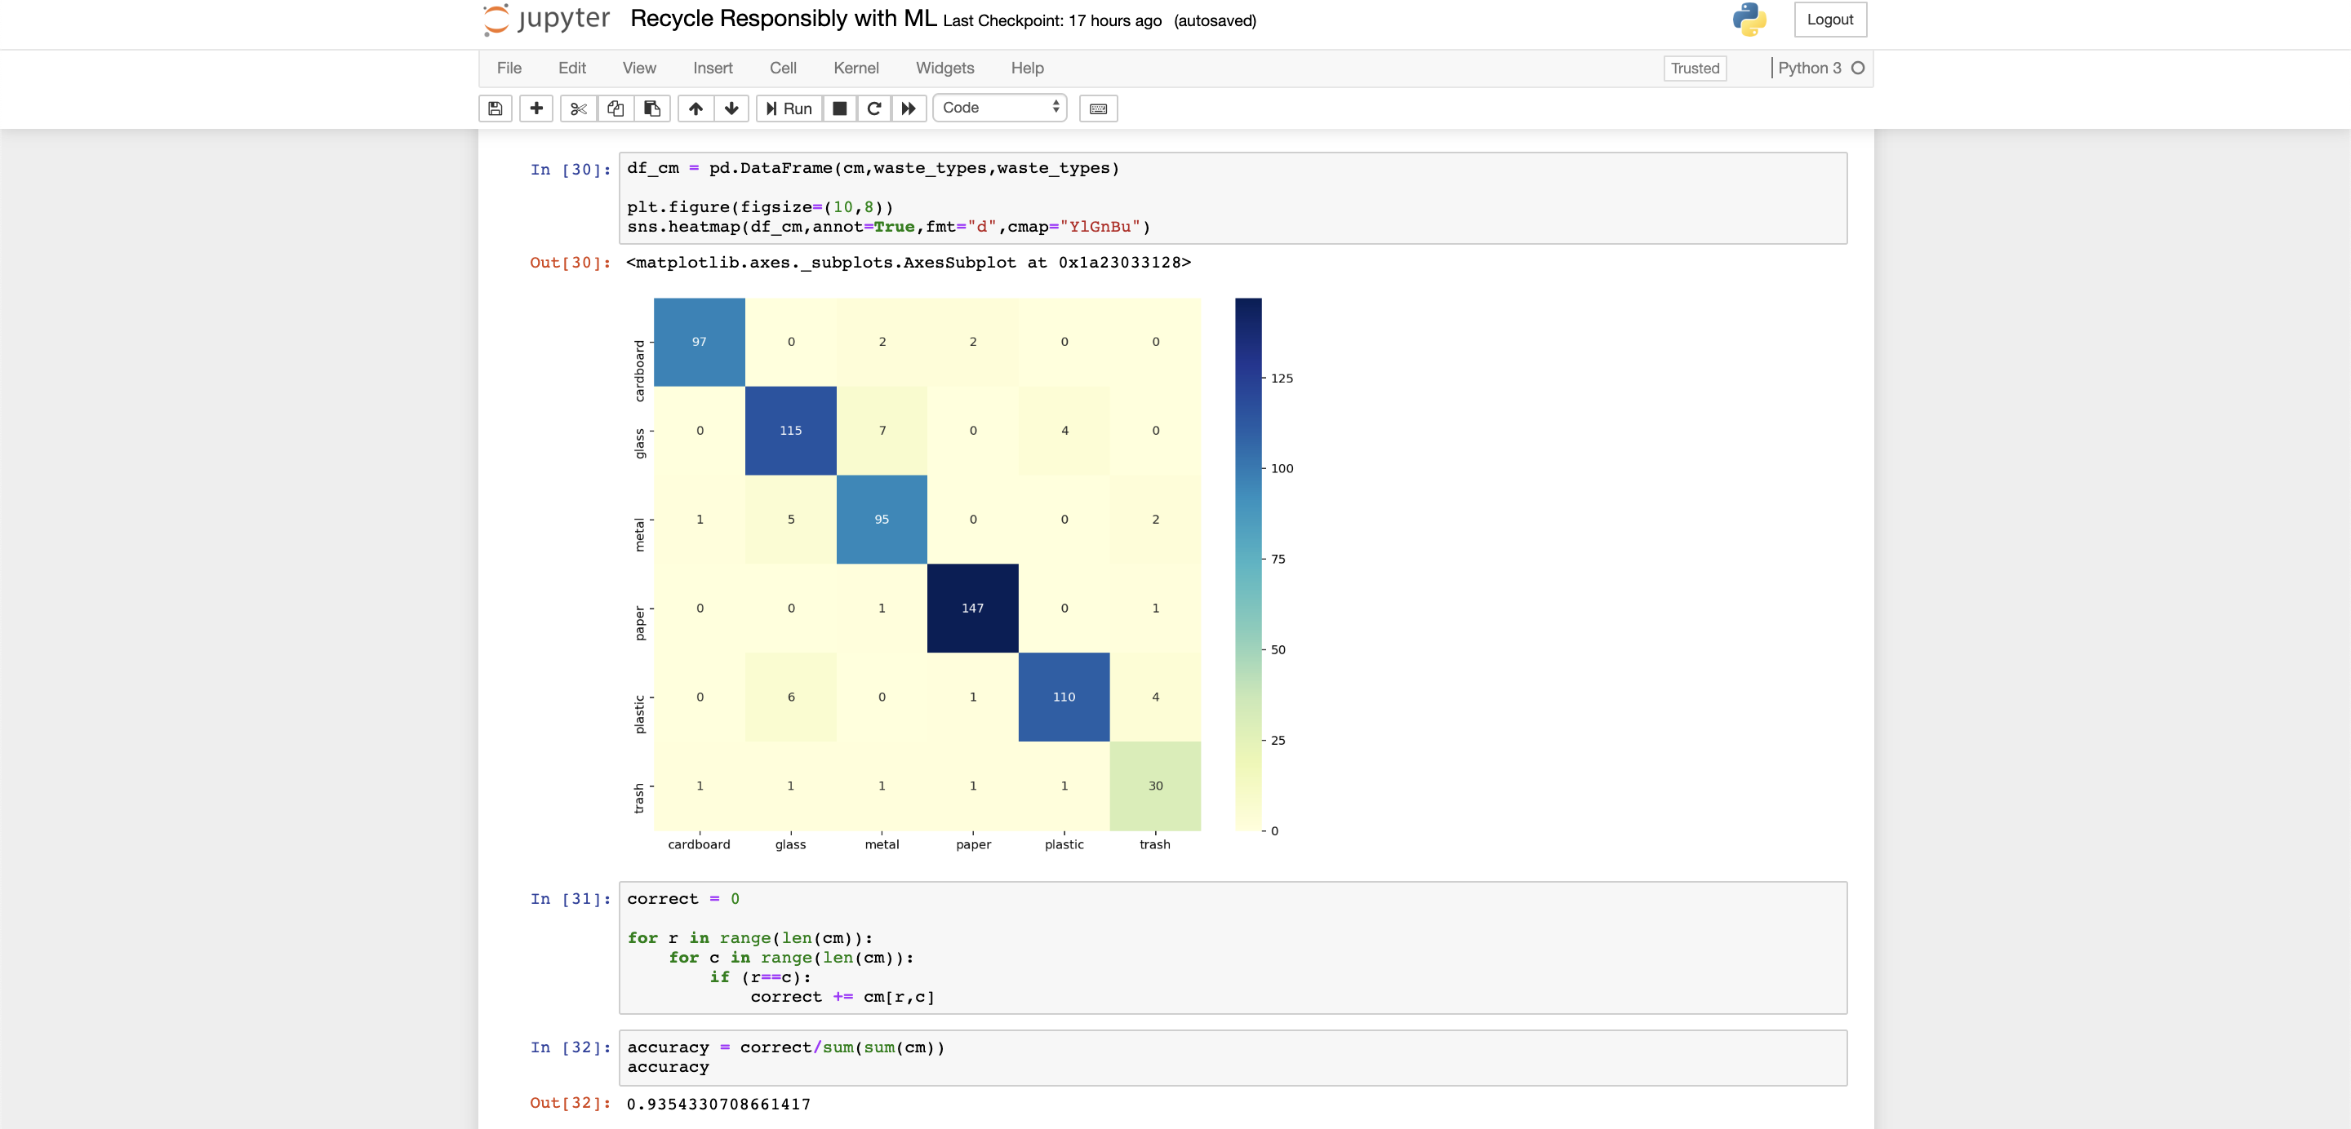

Slide 16


Slide 17

How can we play our part?
In conclusion..

Slide 18

Reduce
Reuse
Recycle
Repeat

Slide 19
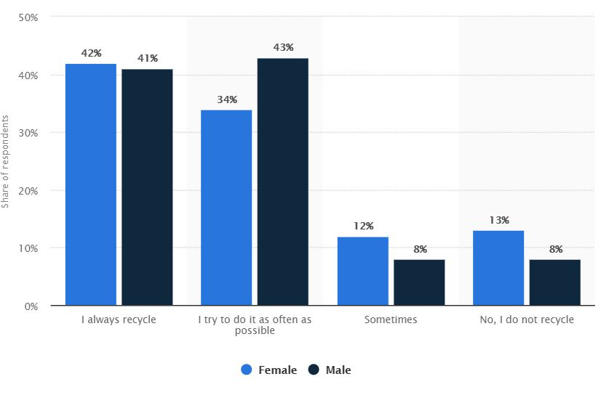
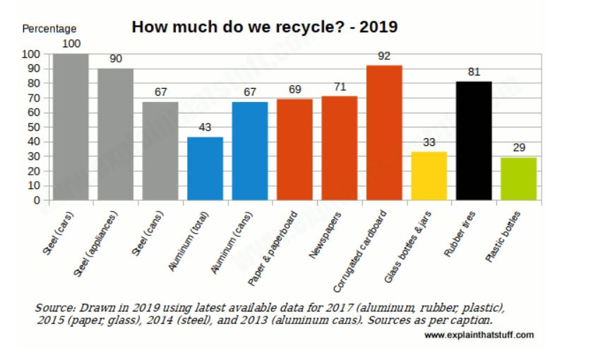
Recycling usage stats
Source: https://www.statista.com/statistics/695444/americans-participating-in-recycling-in-the-united-states-by-gender/
Source: https://www.explainthatstuff.com/recycling.html
Notes:
*2017 Survey, women recycle more than men, recycling rates

Slide 20
“Increasing materials recycling in the US to 60% could save the equivalent of 315 million barrels of oil per year!” Source: https://learn.eartheasy.com/guides/recycling-basics-for-the-home/

Slide 21
Recycling Tips
Work
Use a mug
Go Paperless
Use recycle bin instead of trash
Home
Have a trash can and a recycle bin.
Paperless bills
Recycle/re-use newspaper or magazines
Travel
Bring a small plastic bag to store recycling items in.
Most hotels and airports have recycling bins.

Slide 22
Thank you

